Slide 1
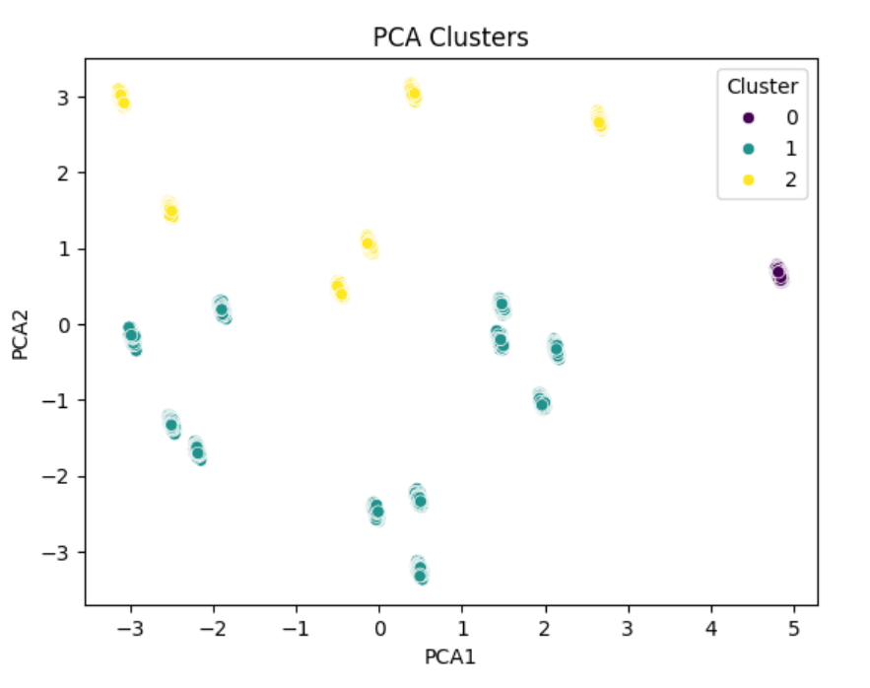

Analysis Of Greenhouse Plant Growth Metrics Using Machine Learning Techniques
Introduction: Plant Growth data from green house environments is analyzed
Features Analyzed: Growth metrics (e.g. ACHP, PHR, RFW) are examined.
Patterns and Groupings: Correlation heatmaps and clustering reveal similarities among plants
Why it matters: Identifying patterns helps optimize greenhouse cultivation

